Slide 1
John Woodward University of Stirling
<number>
03/04/14
Towards the Automatic Design of Algorithms:
The (semi-)automatic design of (heuristic) algorithms
John Woodward, Edmund Burke
John.Woodward@cs.stir.ac.uk
CHORDS GROUP
University of Stirling
Notes:
Miller and langdon, SPECIAL ANOUNCEMENT
SELF CONTAINED
IMPROVE THIS TALK EACH TIME I GIVE IT
TAKE THE OTHER TALKS WITH ME TOO.
<number>

Slide 2



Motivation: One Man – One Algorithm
John Woodward University of Stirling
<number>
conferences. In this paper we propose a new algorithm…
Edsger W. Dijkstra: "two or more, use a for (loop)"
Human 1
Heuristic
Algorithm1
Human2
Heuristic
Algorithm2
Human3
Heuristic
Algorithm3
Notes:
Ga
Ga’
Ga ‘ version 2.o
Ga ‘ version 2.o hydidized with knobs and whistles.
<number>

Slide 3
03/04/14
John Woodward University of Stirling
<number>
Optimization & Machine Learning
Optimization:
  single-stage process.
  aim : find optima. BENCHMARKING
Machine Learning:
  two-stage process, train and test.
  aim is generalization from training set to test set
Clear separation of training and testing problem instances in Machine Learning but not in Optimization.
Building an optimizer is a machine learning problem.

Slide 4
Theory & Practice
John Woodward University of Stirling
<number>
03/04/14
Problem Class
Probability
Distribution over
problem instances
Automatic design
of a heuristic
For a problem class
Building optimizers
is machine learning
Manual Design
Of Heuristic
In isolation
Automatic Design
1. Genetic Programming
as a Hyper-heuristic
2. Genetic Improvement
Of source code
Notes:
Ga
Ga’
Ga ‘ version 2.o
Ga ‘ version 2.o hydidized with knobs and whistles.
<number>

Slide 5
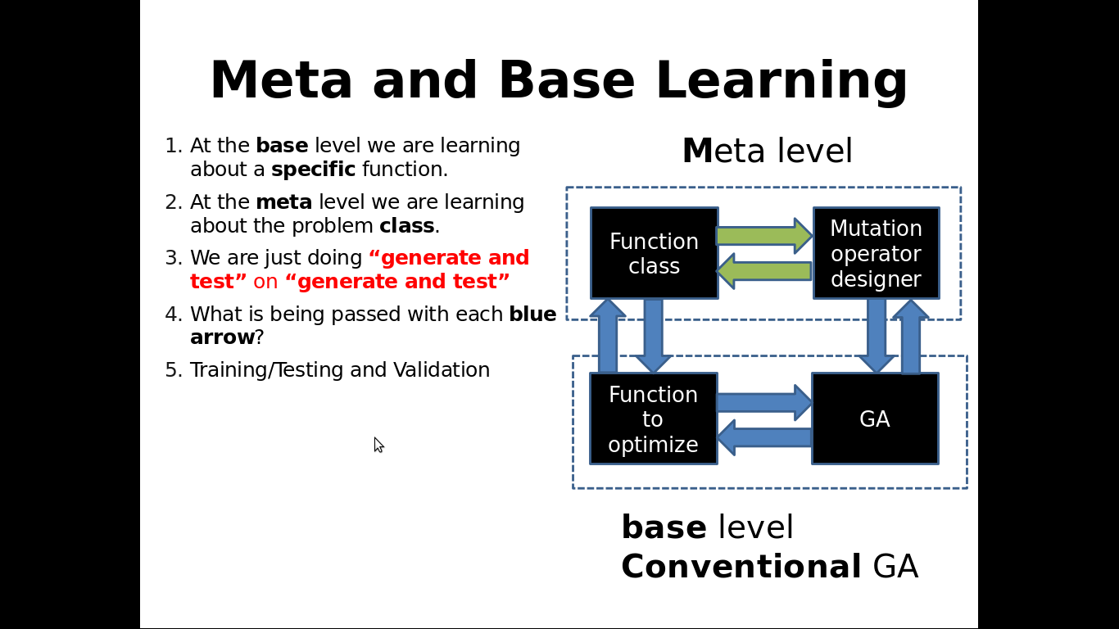

Slide 6
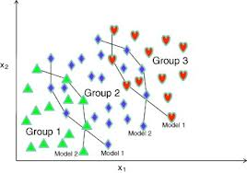
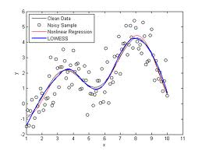
John Woodward University of Stirling
<number>
03/04/14
(Linear) Genetic Programming (Programs)
1. Assign a
Fitness value
to each program,
Fit(Rpt R1, Clr R4,…) = 99.99
Breed a population
of PROGRAMS.
weight
Inc R1, R2=R4*R4…
Rpt R1, Clr R4,Cpy R2 R4
R4=Rnd, R5=Rnd,…
If R1<R2 inc R3,
…
height
Programs for
Classification,
and Regression.
3. Mutate each individual
Rpt R1 R2, Clr R4, Cpy R2 R4
One point mutation
Rpt R1 R2, Clr R4, STP
2. Select the better/best with higher probability from the population to be promoted to the next generation. Discard the worst.
output
input
Notes:
Any problem on a computer can be represented as a bit string.
e.g. knapsack problem, combinatorial problems.
<number>

Slide 7
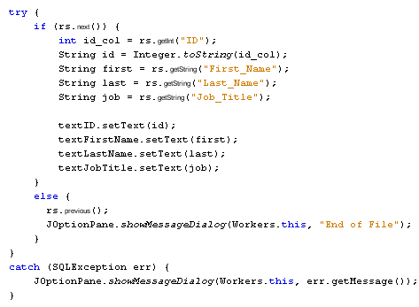
03/04/14
John Woodward University of Stirling
<number>
Genetic Programming as a Hyper-heuristic
Generate and test.
Operate directly on GP syntax trees (lisp s-expression)
Hyper-heuristic because operate on solution space via space of programs.
We evolve part of algorithm (after examining literature of domain).
Is distinct from Genetic Programming
We only allow Genetic Programming
To alter part of the program.
The final algorithm is part man-made and part machine-made.

Slide 8
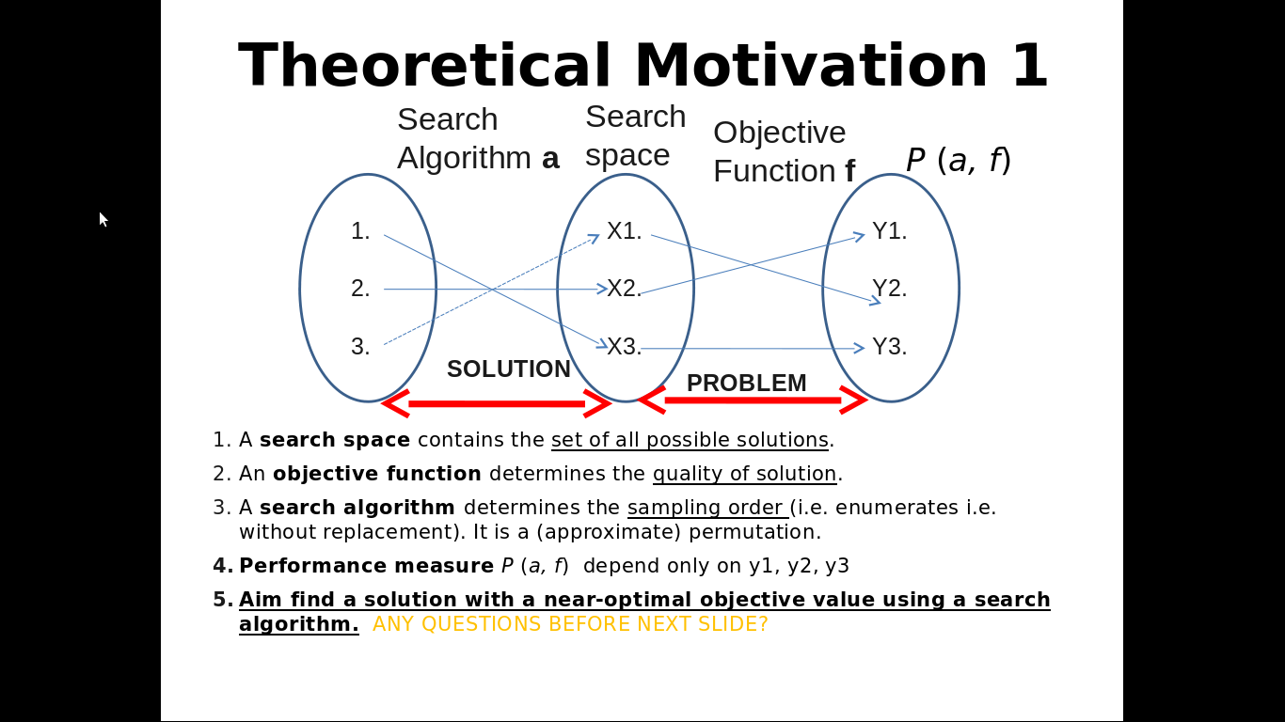

Slide 9
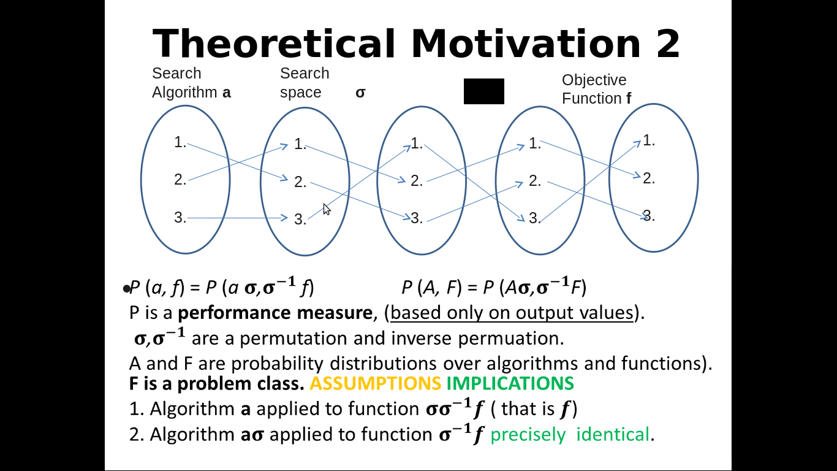

Slide 10
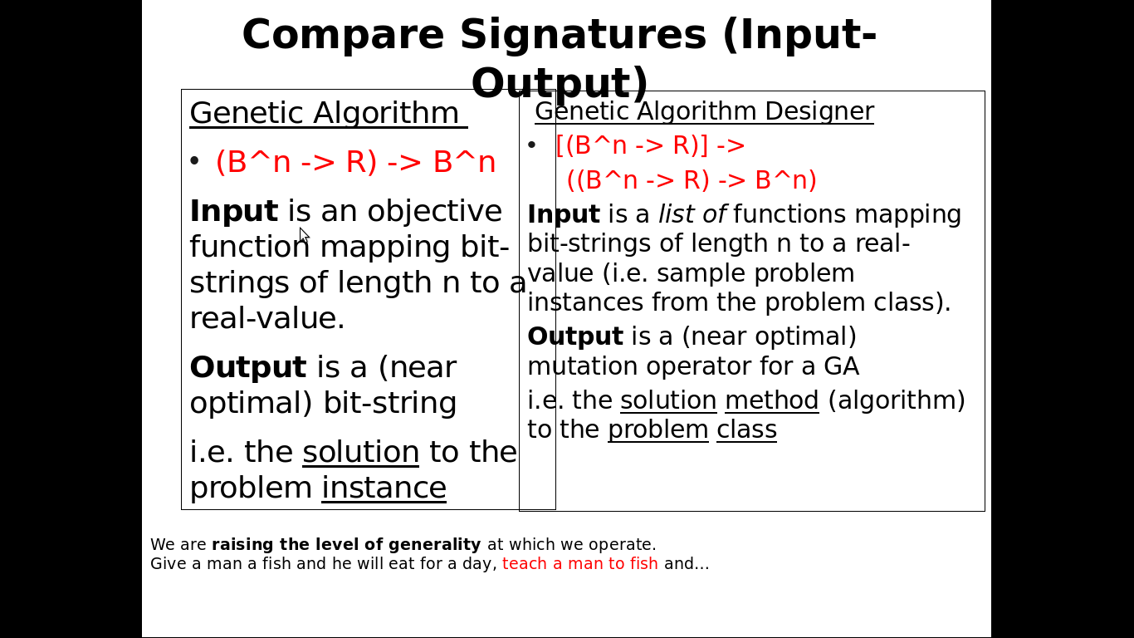

Slide 11
03/04/14
John Woodward University of Stirling
<number>
On-line Bin Packing
Array of bins
Range of
piece size
20-100
150 =
Bin
capacity
Pieces packed so far
Sequence of pieces to be packed

Slide 12
<number>
How the heuristics are applied
%
C
-
C
+
-15
-3.75
3
4.29
1.88
S
F
70
120
85
70
90
60
45
30
30

Slide 13
Human & Machine Heuristic

Slide 14
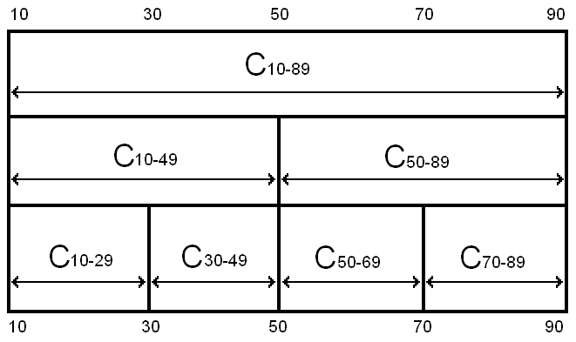
<number>
Robustness of Heuristics
= all legal results
= some illegal results
Notes:
<number>
Even though the problem is the same, and the hard constraints are the same, the heuristics can fail to stay within the hard constraints if they are asked to pack piece sizes they have not seen before
The safeguards against giving illegal solutions that work in one class will not work in another

Slide 15
03/04/14
John Woodward University of Stirling
<number>
Compared with Best Fit
Amount
evolved
heuristics
beat
best fit by.
Number of pieces
packed so far.
Averaged over 30 heuristics over 20 problem instances
Performance does not deteriorate
The larger the training problem size, the better the bins are packed.

Slide 16
More Productivity?
<number>
Algorithms investigated/unit time
One person
proposes one
algorithm
and tests it
in isolation.
One person proposes a
family of algorithms
and tests them
in the context of
a problem class.
Human cost (INFLATION) machine cost MOORE’S LAW
conventional approach new approach
Notes:
What could you do after this talk you could not do before.
<number>

Slide 17
<number>
Conclusions
Algorithms are reusable, “solutions” aren’t (e.g. TSP).
We can automatically design algorithms that consistently outperform human designed algorithms (on various domains).
Heuristic are trained to fit a problem class, so are designed in context (like evolution). Let’s close the feedback loop! Problem instances live in classes.
We can design algorithms on small problem instances and scale them apply them to large problem instances (TSP).
The construction of a optimization algorithm is a machine learning problem.
We can automate this design process with a higher level of abstraction (Hyper-heuristics or Genetic Improvement)
Notes:
I hope if you are a researcher in the field it has made you think
If you do not know how to write an algorithm, don’t write it, let the computer write it. .
<number>

Slide 18
<number>
I have a bus to catch
Workshop on Automatic Design of Algorithms at GECCO.
Tutorial at PPSN.
7 phd positions at Stirling Uni.
Question comments?

